Slide 1




Welcome to Year 2
Notes:
Hello,
Thank you for taking the time to watch and listen to our Welcome to Year 2 talk. I will be discussing about the year group and then the Yr2 curriculum and assessment. There will hopefully be a SATs meeting later in the year when more guidance has come out and things are clearer.
We are aiming to catch your children up as much as possible with new planning provided by Hampshire to transition between Year 1 areas they have missed into Year 2.
Our school day has a similar structure to Year 1 but throughout the year we aim for greater independence in preparation for your child’s next school.

Slide 2
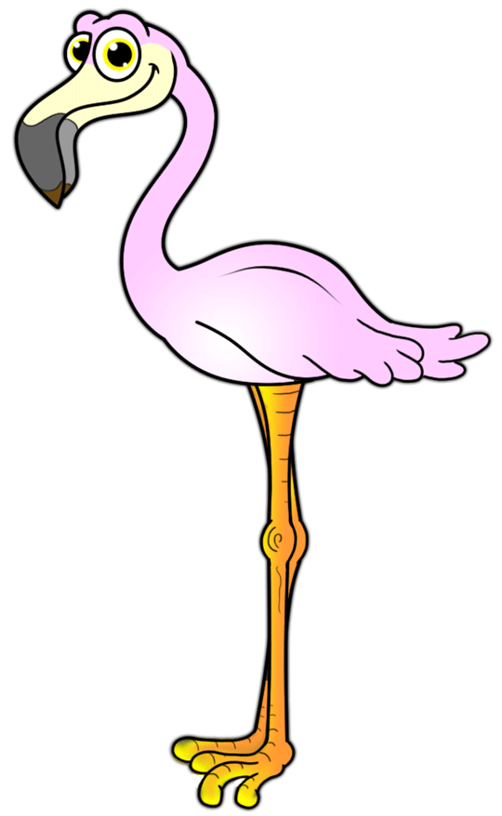




Year 2 Team
Notes:
The Year 2 Team has 4 classes, with a job share in Penguin class.
Mrs Cox is the teacher in Owl Class, Miss Spencer is the teacher in Flamingo Class, Mrs Heath is the teacher in Puffin Class and then we have both Mrs Tamblin and Mrs Freeman who are the teachers in Penguin Class.

Slide 3
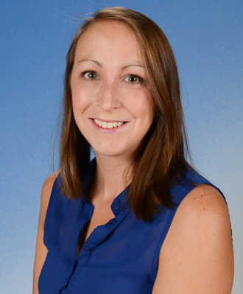

Year 2 Team
Mrs Lovegrove
Notes:
In Year 2 we have LSAs in the morning. Mrs Lovegrove will be in Penguin Class, Mrs Coombs will be in Flamingo Class, Mrs Simpson will be in Owl Class and Mrs Roberts will be in Puffin Class. Our LSAs only work in the mornings in the classroom, but some may be around in afternoons to complete other SNA roles such as interventions.

Slide 4
Additional Teachers
Notes:
All teachers have some time out of the classroom for Planning, Preparation and Assessment. Mrs Gath may cover your child’s class.
Mrs Ross is our SENDCo and she is available to support children with any special or additional needs.

Slide 5
Support Staff
Notes:
We have some lovely support staff in our school. Some children will receive extra assistance from a Special Needs assistant usually in the afternoons.

Slide 6
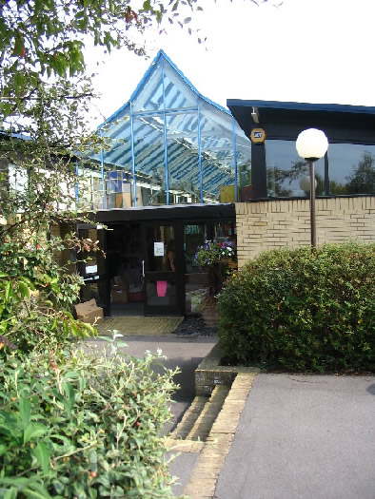
Year 2 Daily Routine
PE:
Once a week – outdoor/indoor
Letters and notices
Parents Evening October
Website
Parent mail
School office
Notes:
Same as in year 1 your child is encouraged to come into school independently and put their own things away. Please make sure names are on all your child’s things this makes it much easier for them.
Yr 2 is really busy, expect a few tired children for the first half term. The pace is much quicker and more will be expected of the children.
Parents evening will be held in October.
Notices on the outside door. Letters home via parent mail.
If you need to see your class teacher then pop a note in the reading record or speak to a member of staff on the door and we will arrange a mutually convenient phone-call.
PE and Library change days will be displayed on door. You can use the school website to find out information about the year group and look at copies of the newsletters in the parents section.
We will be sending home Phonics and Maths booklets with information about how we teach these two subjects and ideas to help at home are also there. These letters can also be viewed in our reception area.
We do fit a lot into our mornings.
Children will do spellings, handwriting, phonics, English, Maths and reading before lunch.
The children will be taught in their own classes for everything given the recent circumstances however this could change for phonics and maths later in the year.

Slide 7

Trips and educational experiences
Titanic Museum Trip – 3rd and 4th November
Forest Friends
Notes:
We have a company from the Titanic Museum in Southampton (Sea-City) coming in on these dates to kickstart our disasters topic for next half term. There will be a letter coming out about this soon.
Forest Friends is where the children will have time every week to experience outdoor learning sessions. This could include story-times outside in our woodland, learning academic subjects outside, making potions or dens, building up on teamwork skills or even creating their own campfire.

Slide 8
After School Clubs
French
Judo
Football
Koosa Kids
Breakfast Club
Wild Things
Notes:
Koosa will be running their breakfast and afterschool club. As the weeks go on we will let you know when other clubs may be reintroduced and starting.

Slide 9

Christmas and Easter
Year 2 will try and perform a Christmas production which will be put up on YouTube. Updates on these performances will come out when they can.
We will be hopefully be holding an Easter craft afternoon at the end of the spring term.
Notes:
Hopefully we will perform a Christmas production in December time which will be filmed and placed on YouTube. Instead of a Christmas craft afternoon we will be hoping to hold an Easter event where parents will be invited if the current Covid 19 restrictions have been lifted. We hope to continue sewing with the children. Then in the summer year 2 children will hopefully perform in a leavers play.

Slide 10
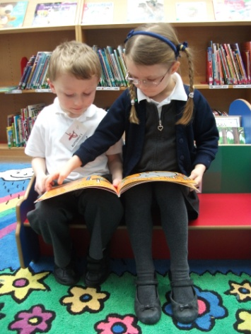
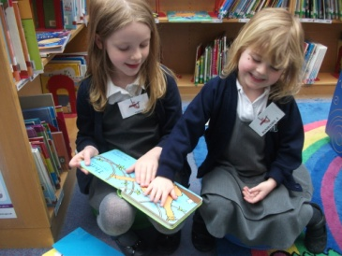
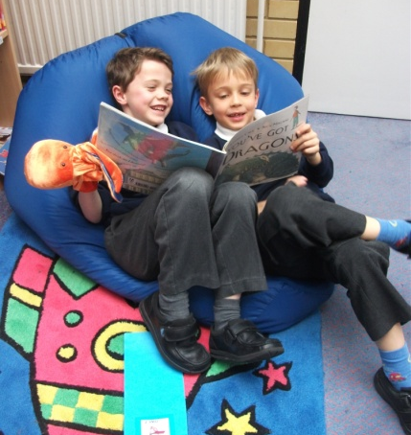
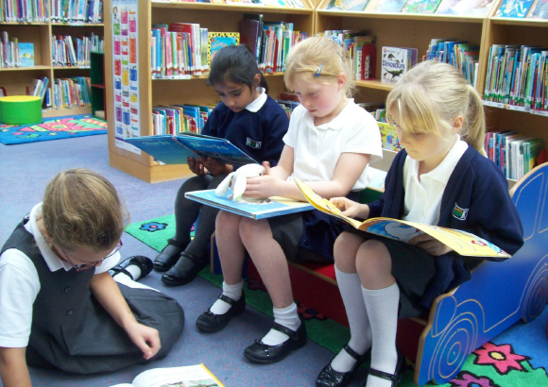
Library
Children will continue to bring a school library book home each week. This is a book of their own choice.
Notes:
Please remember books on the day, or put them in book bags when they are finished at home.

Slide 11
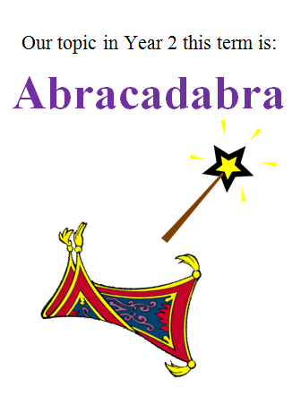


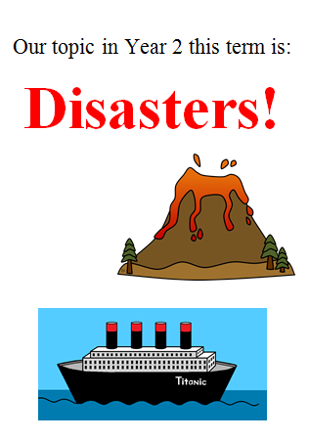
Our Curriculum
Notes:
Details of our curriculum each term can be found on the website in the form of our ‘How to help your child’ leaflet.
We take a topic based approach to our teaching.
This leaflet outlines the objectives the children will be aiming to achieve in school and will give some suggestions for what you can do at home to help them with their learning.

Slide 12
Homework
All children need to read with an adult everyday.
Learn weekly spellings usually tested on a Monday.
Practise handwriting and letter formation.
The children will have a marvellous maths sticker in their reading diaries.
Overlearning and research can be linked to each terms topics.
Homework is a great opportunity for parents to be involved with your child’s learning.
Notes:
Any additional tasks will be given in their reading diaries / spelling test books.

Slide 13


Our reading scheme
Our reading scheme books are organised into coloured book bands according to their difficulty level and skills required to read them. Language is progressive within some sets of books so we ask the children to choose the next book in that set if possible, or return to it at a later date.
Each colour band has a range of genre.
Children need to experience a range of fiction,
non-fiction and poetry within each level.
Children move a level when we feel they are ready for
the next challenge and have read across the
range of genre at their existing level.
Children will begin to bring reading worksheets
home to deepen their understanding of the text.
This will be instead of changing their book.
Notes:
Our reading scheme is split into year group reading schemes.
The year 2 reading scheme runs through to Lime +
which are a mixture of longer age appropriate texts ready for the transition to the Juniors.
For your child to be at ARE (Age Related Expectations) at the end of year 2 we would need to ideally be reading confidently from Purple - Gold Level books to be able to answer the expected comprehension papers.

Slide 14
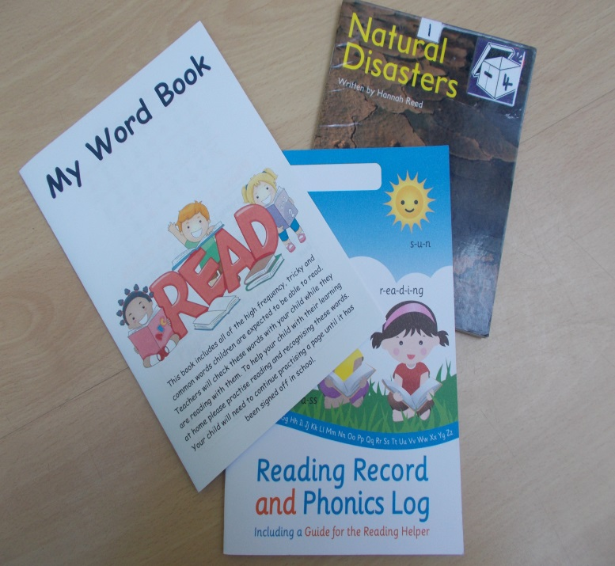
Reading
Children read throughout the school day.
We aim for each child to be heard twice a week in school with an adult or helper using either a class text or their reading book.
Children can change their own book when there is a note to say it has been read in their reading record.
We continue to follow up the first words and high frequency words as in Year 1. This is now in My Word Book.
Notes:
We are not expecting a book to be read each night as some are 40 pages long!
‘My Word Book’ is used to support pupils who need practise with their reading skills.

Slide 15
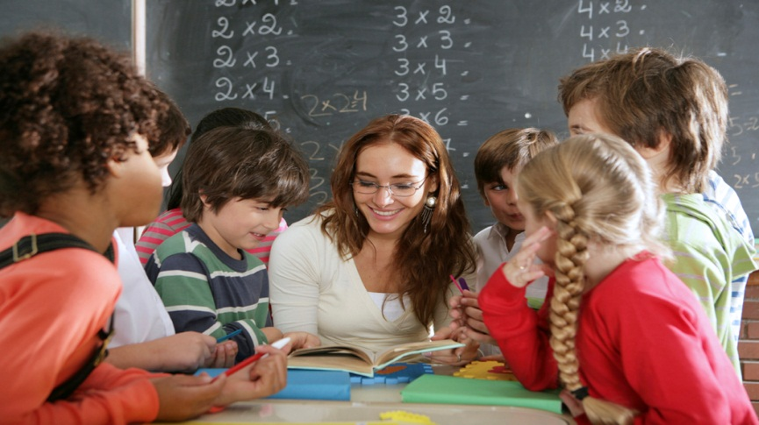
Guided Reading/Comprehension
Guided reading sessions happen most weeks to teach specific reading skills.
Usually they will be marked in your child’s reading record with a stamp.
The emphasis in these sessions is usually comprehension or understanding. It encourages discussion including the features of a text, characters, events and making comparisons between books of the same theme.
Notes:
Guided reading is in a group where the children look at the same text, we encourage discussion and concentrate on understanding the text.
Ask children questions about their books.
Looking for clues in the text.
Checking understanding of vocabulary.
Who are the main characters?
Tell me about the characters? What do you know from what you have just read?
Vocabulary check and widen - What word tells us that the boy was feeling happy?
What do you think might happen? How do you know that? – prove it, find the answer in the text
We will get them to find the answers in the text.

Slide 16
Reading at home
Hearing your child read is one of the most beneficial things you can do because…
You are supporting and reassuring them.
You are giving them a reason to read.
You are building their confidence.
You are helping them with a skill that is integral for life-long learning.
You are spending time with your child.
Notes:
Please continue to support your child’s reading at home on a daily basis.
For children to succeed in reading they need to be heard regularly at home.
An ability to read well ensures that children can access all areas of the curriculum as they continue in their education

Slide 17
Phonics in Year 2
Phonics is taught each morning for 20 minutes.
There will also be a recap before lunch in reading time.
The children are remaining in their same classes and will be assessed frequently by the class teacher and LSA.
Word-Book practise at home will be amazing to support your children as they have missed the phonic screening in year 1.
The children will be assessed in the Autumn Term on their phonics.
Notes:
Phonics is delivered across the year group in our own classes. We will aim to recap Year 1 (phase 5 ) and we will introduce phase 6 near the end of Autumn Term.
In the middle of the reading record you will find phonic sounds to practice at home.
Phonics games on the computer at home. You will find the phonics stuff on the bottom of the yr 2 page
On the school website there is a guide to Progression in Phonics, phonic sound chart and phonic assessments.
When you are reading with your child discuss the sounds within the words and how the same sound can be written in different ways.

Slide 18
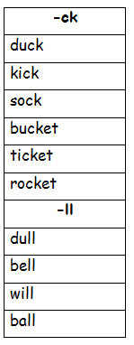
Spellings
Children will get new weekly spellings to take home and learn in their red spelling book. These will link to the spelling rules we have been learning in our Phonic sessions.
Spellings will be tested on a Monday.
Spellings are usually given out on a Monday/ Tuesday.
The children are encouraged to:
look, say, cover, write, check
Notes:
Their spellings to learn will be stuck at the front of the book and their spelling test in school will be carried out at the back of the book.
In addition children will also have an in class spelling session daily which will look at the different spelling rules and new grammar (eg nouns, past tense) children are expected to know in Year 2.
SHOW ‘My Spelling Rules Book’
This outlines the spelling rules the children are expected to use and apply correctly to reach ARE in Yr2.
Please look out for in in your child’s book bag

Slide 19
SATs/End of Key Stage Assessments
During May our Year 2 children will sit the SAT’s papers.
Children will take SATs in:
  Reading – Comprehension
  Maths – Mental Arithmetic and Reasoning
  Stress free! Children are not always aware they are doing any ‘tests’.
Writing and Science assessments are ongoing throughout the year.
Notes:
Stress free! The children will be used to doing this style of test. They will have come across them before. They will know the set up.
We regularly assess to inform our teaching.
Assessments are carried out to see if your child is working at the expected level half termly.
We constantly plan the next steps that your children need to progress - often these are communicated with the children through targets, marking comments and reading sticker targets

Slide 20
Marking
All assessments, including the test papers are marked by your own child’s teacher and then are moderated rigorously.
English writing and science will be assessed by your child's teacher based on their work throughout the year.
You will receive your child’s results with their report in July. This will say if they have achieved the required standard in the tests.
Notes:
We moderate as a year group,whole school, with the Juniors, and as a local school cluster group. We are also externally moderated by Hampshire County Council and attend moderation meetings in the Spring and Summer terms.
As part of the SATs moderation the children will be given a standardised score which along with teacher assessments will be used to build up a picture of your child’s learning and achievements.
Your child will receive an overall result saying whether they have achieved the required standard in the tests.

Slide 21
KS1 Reading
Paper 1 consists of a selection of texts with questions interspersed.
Paper 2 comprises a reading booklet with a selection of passages. Children will write their answers in a separate booklet.
Each paper is to be attempted and should take around half an hour.
The texts in the reading papers will cover a range of fiction, non-fiction and poetry.
Notes:
The reading test for Year 2 pupils will involve two separate papers
1 consists of a selection of texts totalling 400 to 700 words, with questions interspersed
2 comprises a reading booklet with a selection of passages. Children will write their answers in a separate booklet.
A total score from both papers is taken, they should take around 30 minutes, but children will not be strictly timed, as the tests are not intended to assess children’s ability to work at speed.
The texts in the reading papers will cover a range of fiction, non-fiction and poetry, and will get progressively more difficult towards the end of the test.
Teachers will have the option to stop the test at any point that they feel is appropriate for a particular child.

Slide 22
KS 1 Reading
There will be a variety of question types:
Multiple choice
Ranking/ordering
Matching
Labelling
Find and copy
Short answer
Open-ended answer
Notes:
There will be a variety of question types:
Multiple choice
Ranking/ordering, e.g. ‘Number the events below to show in which order they happened in the story’
Matching, e.g. ‘Match the character to the job that they do in the story’
Labelling, e.g. ‘Label the text to show the title’
Find and copy, e.g. ‘Find and copy one word that shows what the weather was like in the story’
Short answer, e.g. ‘What does the bear eat?’
Open-ended answer, e.g. ‘Why did Lucy write the letter to her grandmother? Give two reasons’
Emphasis for higher ability readers is on comprehension and reading aloud with an audience in mind – fluency, taking note of punctuation, expression.

Slide 23
KS1 Maths
Paper 1: Mental arithmetic, 25 questions to answer in 25 minutes.
Paper 2: Mathematical fluency, problem-solving and reasoning. There will be a variety of question types: multiple choice, matching, true/false, constrained (e.g. completing a chart or table; drawing a shape) and less constrained (e.g. where children have to show or explain their method).
Children will not be able to use any equipment such as calculators or number lines.
Notes:
The Key Stage 1 maths test will comprise two papers:
Paper 1: arithmetic, worth 25 marks and taking around 20 minutes. Only using mental fluency
Paper 2: mathematical fluency, problem-solving and reasoning, worth 35 marks and taking approximately 35 minutes, with a break if necessary.
There will be a variety of question types: multiple choice, matching, true/false, constrained (e.g. completing a chart or table; drawing a shape) and less constrained (e.g. where children have to show or explain their method).
Children will not be able to use any equipment such as calculators or number lines.

Slide 24
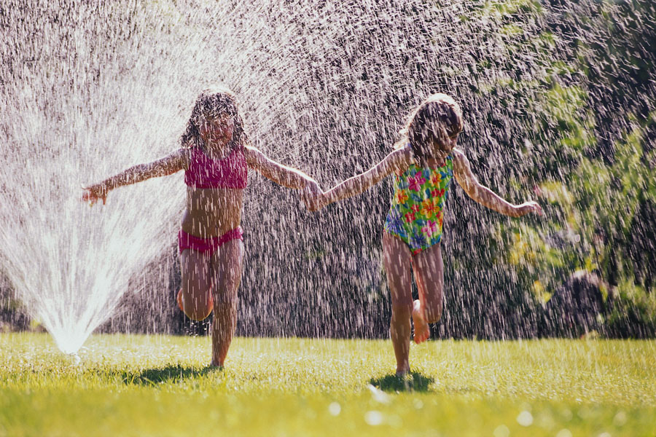
There is more to life!
Notes:
A gentle reminder to - Please don’t get too worried about them.
At this point every year
where we need to get to feels like a long way away but the children do make it.
Hopefully they will enjoy the new topics along the way.

Slide 25
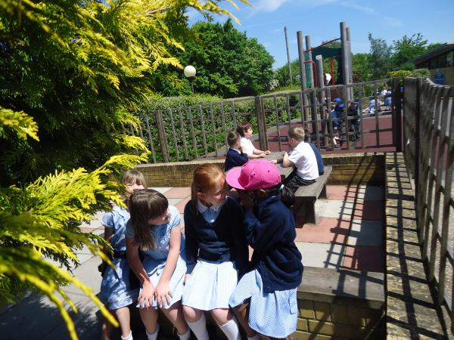
Every child matters
Children learn at different rates and through different experiences. We are here to ensure the progress of every child whatever their ability.
If you have any queries please make an appointment to see us.
Notes:
Well being of your children is a priority. If you have any queries or worries please make an appointment

Slide 26


Notes:
Thank you – if any changes happen we will ensure to let you know as soon as we can. Thank you for your time and I hope this has been useful.

