Slide 1
Phonics Workshop
Phases 2 and 3

Slide 2
What is phonics?
Phonics is a way of teaching children to read and write.
Children learn the phonemes associated with graphemes. They blend them for reading and segment them for writing.
Phoneme = the smallest unit of sound in a word.
Grapheme = letter.
Blending = children read/say/hear the separate sounds in a word and blend them together to make the whole word.
Segmenting = children say/hear the whole word and say every separate sound they hear.

Slide 3
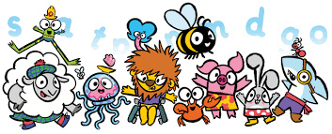
Anima Phonics
At Hook Infant School, we use Anima Phonics, which is accredited by the Department for Education. This is split into phases. In the Autumn term we cover Phases 2 and 3.

Slide 4
Phase 2
Children learn the phonemes (sounds) made by the following graphemes (letters) …
s a t p i n m d g o c k ck e u r h b f ff l ll ss
It is very important to articulate these sounds accurately and to make sure there is no schwa (‘uh’ sound at the end – e.g. say mmmmmm rather than muh).
Visit the Soundboard on Anima to hear the sounds.
https://phonicsresources.net/Online/Resources/SoundBoard1/

Slide 5
Phase 3
Children learn the phonemes (sounds) made by the following graphemes (letters) …
j v w x y z zz qu
ch sh th/th ng ee ar oa or oo/oo ai igh ear ow ur oi air ure er ue
Digraphs are where two letters make one sound.
Trigraphs are where three letters make one sound.

Slide 6
Reading and writing words
Children gradually build up the length of words they can read and write.
VC = vowel consonant e.g. it
CVC = consonant vowel consonant e.g. tin
CCVC = consonant consonant vowel consonant e.g. step
CVCC = consonant vowel consonant consonant e.g. pots
Children will only be expected to read and write words where the graphemes (letters) make the phonemes (sounds) that have already been taught.

Slide 7
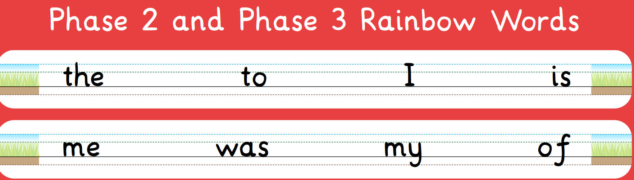
Rainbow words
Rainbow words are common words that contain sounds children might not yet know.

Slide 8


Real words and alien words
Children will be expected to read real words and alien words. Alien words are words that are not real. Children should still be able to read them using their phonic knowledge and should also identify that they are alien. We often do this by playing games such as Buried Treasure – children sort the words into treasure (real words) and rubbish (alien words).
lif
bud
pin
kib
sen
tag

Slide 9
Phonics lessons at school.
At school we have 5 whole class Phonics lessons a week, and many other Phonics activities.
In a Phonics lesson, the children have time to revise what they have already learnt as well as learn new sounds. It is very important to constantly revise what children already know. Both during the lesson and in classroom activities, children are given the opportunity to apply what they know, either through reading activities or games.
You can help at home by doing short sessions with your child as often as possible. A quick 5 minute game every day will help your child to make better progress with reading.

Slide 10
Handwriting
Anima has handwriting families. Every child has brought home a letter formation booklet.
The only way for children to get really good at correct letter formation is to practise, practise, practise …

Slide 11
Writing
By the end of the year, your child should have attained the Early Learning Goal for writing…
Write recognisable letters, most of which are correctly formed;
Spell words by identifying sounds in them and representing the sounds with a letter or letters;
Write simple phrases and sentences that can be read by others.
Children’s INDEPENDENT writing is used for this.
The Fine Motor Skills Early Learning Goal (ELG) is used when we assess handwriting.
Hold a pencil effectively in preparation for fluent writing – using the tripod grip in almost all cases;
Use a range of small tools, including scissors, paint brushes and cutlery;
Begin to show accuracy and care when drawing.

Slide 12
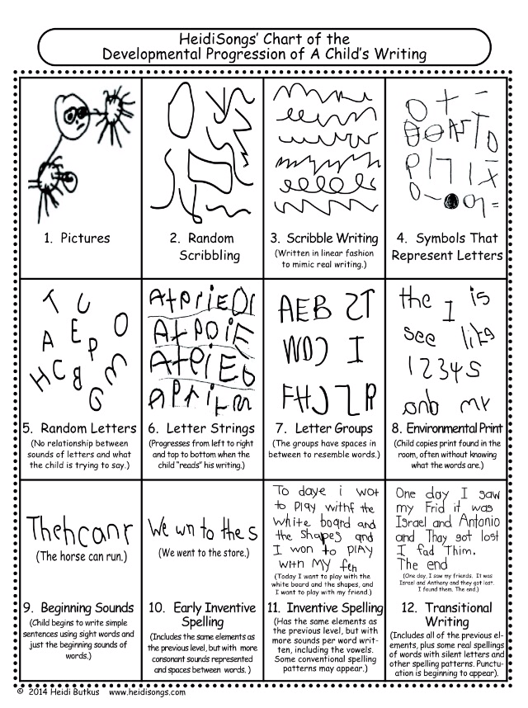

Writing progression
When children come up from Nursery, they are usually working at one of these stages, most will attempt to write their names but few will attempt to write other words.
By the end of the year, we would expect children to be working at one of these stages.

Slide 13
How we teach writing
We frequently demonstrate writing a sentence with the class. Children have the opportunity to go to the writing table to write a sentence. It is okay to use a sound card or to find a word from the word bank.
After Christmas we have Funky Fingers sessions. Two letter formations are taught, children practise writing their name, using scissors and build up fine motor control muscles.
Every week the children will complete a piece of writing with support from an adult. We will teach them strategies to improve their writing.
Phonics sessions support writing.
Children are encouraged to write independently in all areas of the classroom and outside.
The more writing children do, the better they will get. If your child wants to write at home, encourage them! It will help them to build their confidence and become a better writer.

Slide 14
Ideas for games
The best place to get ideas for games is Pinterest. If you search for Phonics Phase 2 (or 3) games, you will get a good selection.
You can adapt the ideas depending on whether your child is learning sounds or reading words.
Here are some ideas …

Slide 15
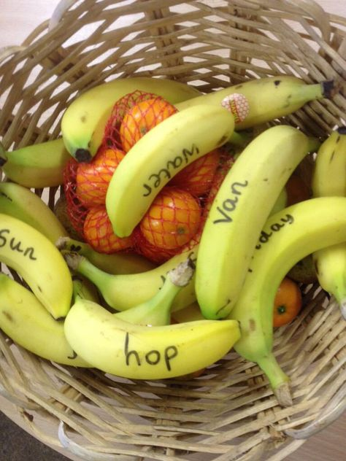
You could write sounds or cvc words on bananas, for your child to read before they can eat them.
You could also do this on other packaging or wrappers.

Slide 16
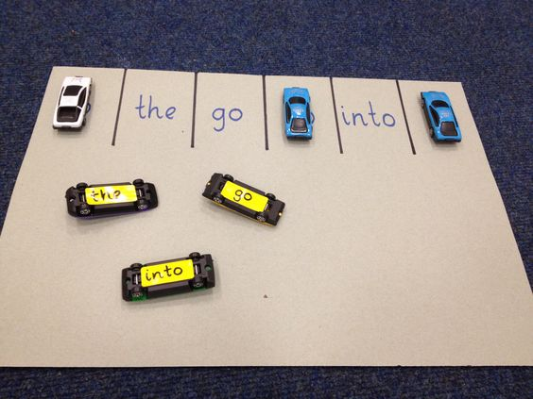
Make a phonics car park. Write the sounds or words on the cars and the parking space, your child can match them up and read them as they park the cars in the right spaces.

Slide 17
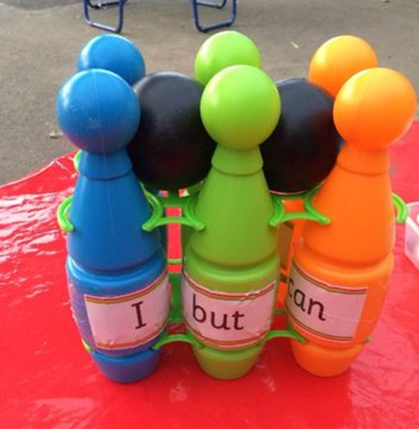
Write sounds or words on skittles. When they get knocked down, your child can read them to you.

Slide 18
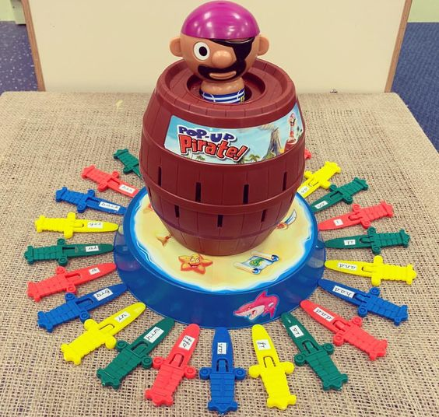
You probably have lots of games at home that you can adapt. If you have Pop-up Pirate, you can write sounds or words on the swords, your child can read these before they can put them into the barrel.

Slide 19
Useful places
There are lots of apps and ideas available that are helpful for children. Try to make sure you have checked it out first and that the phonemes are correctly articulated. Some American apps and sites don’t teach phonics the same way we do and may not be accurate.
Anima Phonics website
Nessy website and apps (including Hairy Phonics)
Zat phonics website and app
Phonics Play website
Phonics Bloom website
Alphablocks videos (BBC – can be found on Cbeebies iPlayer, YouTube and DVD)
Mr Thorne phonics / Geraldine Giraffe (YouTube)
Hook Infant School website and Facebook page

Slide 20
Anima website
Most of the Anima website is subscription only, but there are some resources you can access without a subscription …
Early Worms – https://www.animaphonics.com/earlyworms.html
This is Phase 1 phonics. There are lots of oral segmenting and blending ideas, which are still relevant throughout the whole of Year R.
Soundboard and a few games – https://www.animaphonics.com/soundboard.html
Phase 2 songs – https://www.animaphonics.com/phase2-songs.html
A4 frieze - https://www.animaphonics.com/uploads/9/2/6/9/92698508/a4_printable_frieze_23s22.pdf

Slide 21
School website –
https://www.hookinfants.co.uk/website/year_r/294884
Hook Infant School Year R Facebook Page –
https://www.facebook.com/Hook-Infant-School-Year-R-311362443122757

